Slide 1
Social Vulnerability Across U.S. Counties and States: A Thematic Overview
Bridgett Gordon| MSDS 570: Visual & Unstruct Data Analysis| December 7, 2024

Slide 2
Introduction
Problem Statement * Purpose * Objectives
Notes:
Insert a map of your country.

Slide 3
Problem Statement
Effective resource allocation and intervention planning require a detailed understanding of social vulnerability across different states. However, identifying states with high vulnerability and pinpointing the specific factors driving this vulnerability remain significant challenges. Without targeted insights, efforts to reduce social vulnerability may lack precision, leading to inefficient use of resources and unmet community needs.
Notes:
Insert a picture of one of the geographic features of your country.

Slide 4
Purpose
This study aims to address these challenges by identifying states with high average Social Vulnerability Index (SVI) scores and analyzing the contribution of individual SVI themes to these scores. By highlighting key areas such as housing, socioeconomic conditions, and infrastructure vulnerabilities, this work seeks to enable more focused and impactful interventions tailored to the unique needs of each state.
Notes:
Insert a picture of one of the geographic features of your country.

Slide 5
Objectives
Identify High Vulnerability States: Pinpoint states with high average SVI scores, helping to target areas with potentially greater social vulnerability.
Theme Analysis for Targeted Interventions: Assess which SVI themes contribute the most to the average score in each state, enabling targeted interventions (e.g., housing support in states with high vulnerability from Housing & Transportation).
Notes:
Insert a picture of one of the geographic features of your country.

Slide 6
Dataset overview
Description * Size and Scope * Preprocessing
Notes:
Insert a map of your country.

Slide 7
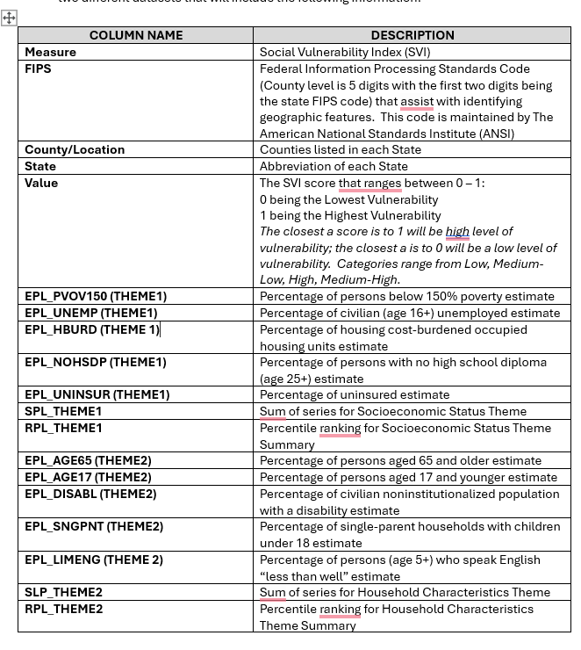
Key variables
Value = SVI Score (0-1)
SPL_THEMES 1-4 = Socioeconomic Profile Layer
State = Continental U.S.
FIPS = Federal Information Processing Standards
Notes:
FIPS= Federal Information Processing Standards Codes (County = 5 digits with the first 2 digits being the State FIPS Code)

Slide 8
Data Description
Names of Datasets:
SVI_USCounty_2020.csv
sdoh_data.csv
Sources of Datasets:
SVI Values by County
https://data.cms.gov/tools/mapping-disparities-by-social-determinants-of-health
SVI Themes by County
https://www.atsdr.cdc.gov/placeandhealth/svi/data_documentation_download.html
Notes:
Insert a picture illustrating a season in your country.

Slide 9
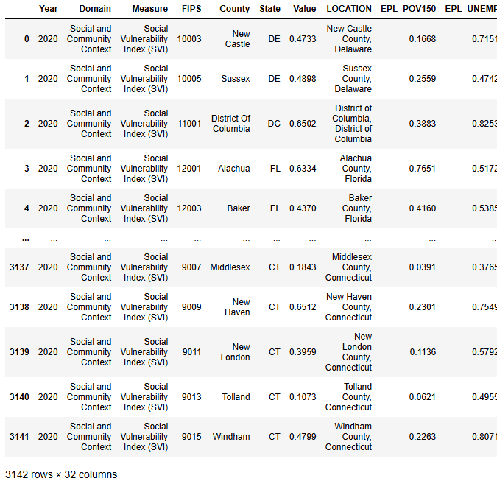
Size and Scope:
Raw Data: 3142 rows x 32 columns
Used .isnull() to check for any missing values, but there were none
Notes:
Insert a picture of one of the geographic features of your country.

Slide 10
Pre-Processing
Merging two Datasets to pull together needed data from each
Check and remove missing values (.isnull())
Filtering to focus on certain variables for specific analysis
Notes:
Insert a picture of one of the geographic features of your country.

Slide 11
Exploratory data analysis (Eda)
Initial Findings
Notes:
Insert a map of your country.

Slide 12
Summary Statistics
County SVI Summary Statistics
Count: 3142
Mean: ~0.5 – the average SVI across all counties which suggests that the SVI scores are evenly distributed across the SVI score range 0.0 to 1.0
Standard Deviation(std): ~.29 indicates moderate variability in the vulnerability levels across counties
A moderate standard deviation (~0.29) suggests that while most counties are near the median (0.5), there are still noticeable differences in vulnerability across the dataset.
State Average SVI
Count: 51
Mean: ~0.48 – on average, the states have a moderate level of social vulnerability.
Standard Deviation(std): ~.18 indicates moderate variability in the vulnerability levels across counties
Most states have scores relatively close to the mean (0.48), but there are some states that deviate substantially toward the lower (0.20) or higher (0.84) ends.
Notes:
Add key points in the history of your country to the timeline.

Slide 13
Methods and tools
Tools * Techniques
Notes:
Insert a map of your country.

Slide 14
Tools and Techniques
Matplotlib
Plotly
Choropleth
Dash
Geopandas
Geoplot
Seaborn
Microsoft Clipchamp
Geospatial mapping
Filtering
Merging
Splitting data
Aggregating Data
Notes:
Insert a picture illustrating a custom or tradition here.

Slide 15
Key Visualizations
Maps * Bar Charts * Heatmaps
Notes:
Insert a map of your country.

Slide 16
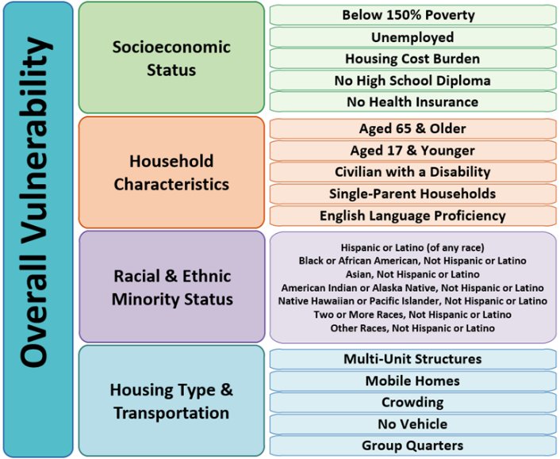
Social vulnerability index themes
SPL_THEME 1
SPL_THEME 2
SPL_THEME 3
SPL_THEME 4
Notes:
Insert a picture illustrating a custom or tradition here.

Slide 17

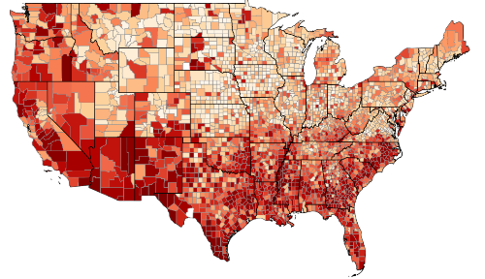
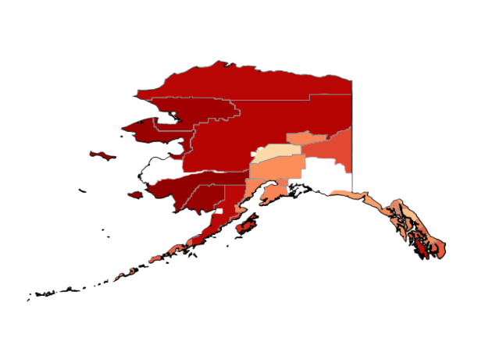
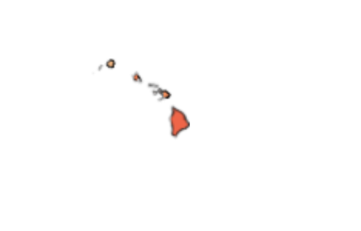
County SVI per State
-1.0
Social Vulnerability Index categories are based on a score that ranges from 0 – 1
0 = lowest vulnerability
1 = highest vulnerability
-0.8
-0.6
-0.4
-0.2
*The closest the score is to 1 will be a high level of vulnerability; the closest the score is to 0 low vulnerability
-0.0
Notes:
Insert a picture of the head leader of your country.

Slide 18
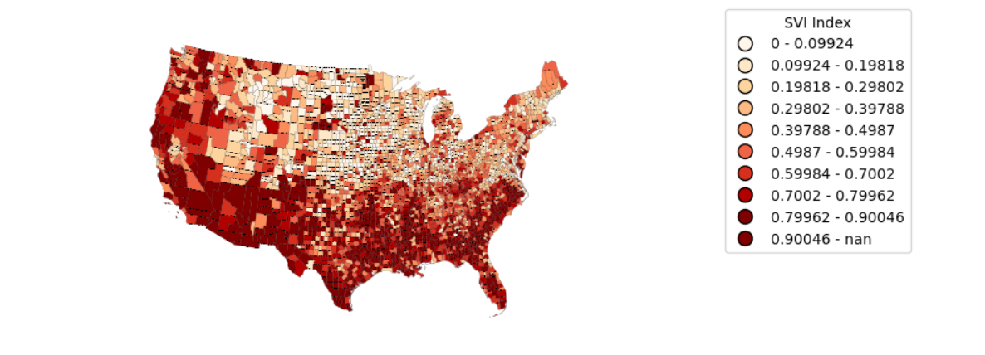
another county view
This visualization was a little more specific in estimating the SVI index for each County
Notes:
Insert a picture of the head leader of your country.

Slide 19
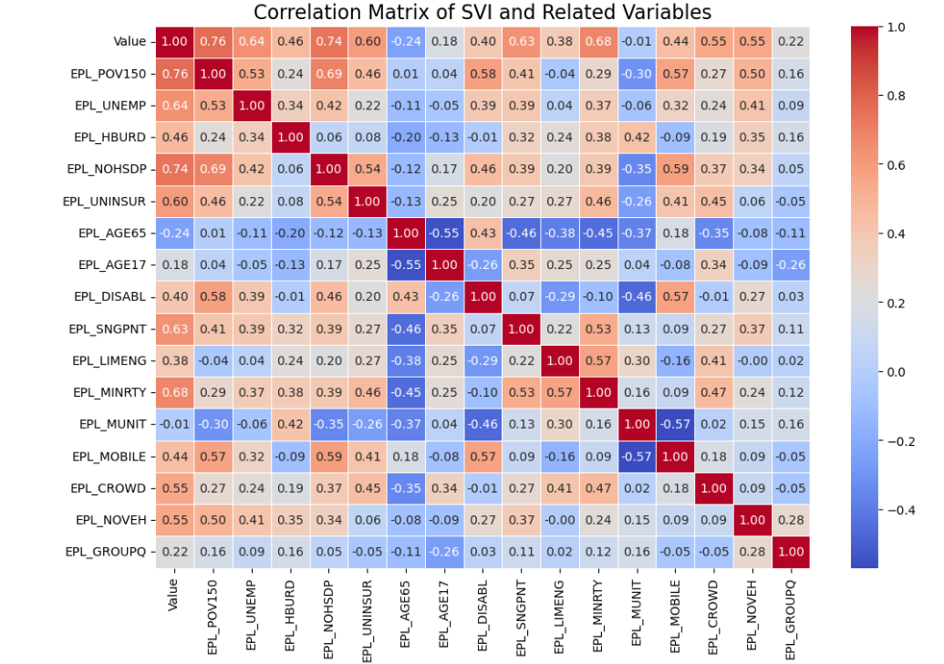
Correlation matrix of svi and economic profile layers
Notes:
Insert a picture that illustrates some part of your country’s economy.

Slide 20
Interactive features
Notes:
Insert a map of your country.

Slide 21
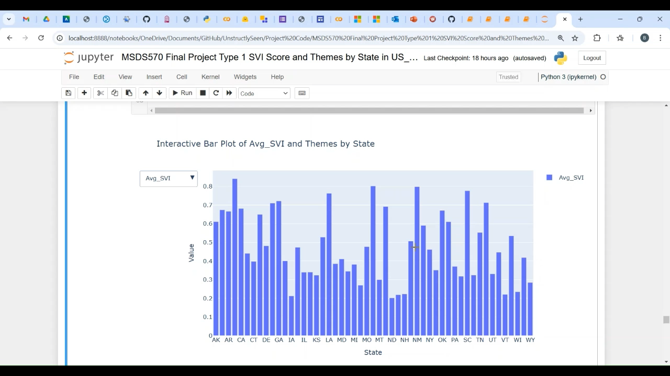
Interactive bar chart: avg_svi and themes by state
Notes:
Insert a picture that illustrates some part of your country’s economy.

Slide 22
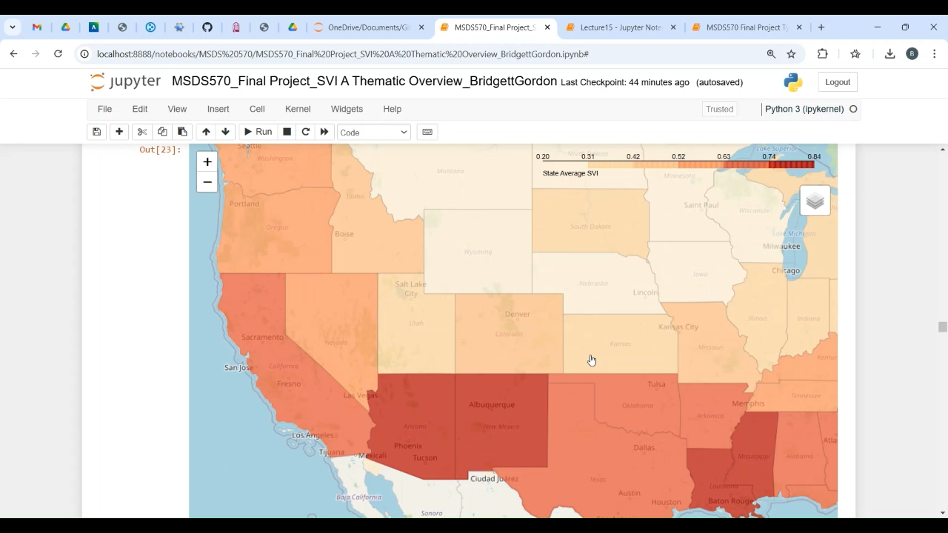
Choropleth map: avg_svi by state
Notes:
Insert a picture illustrating a custom or tradition here.

Slide 23
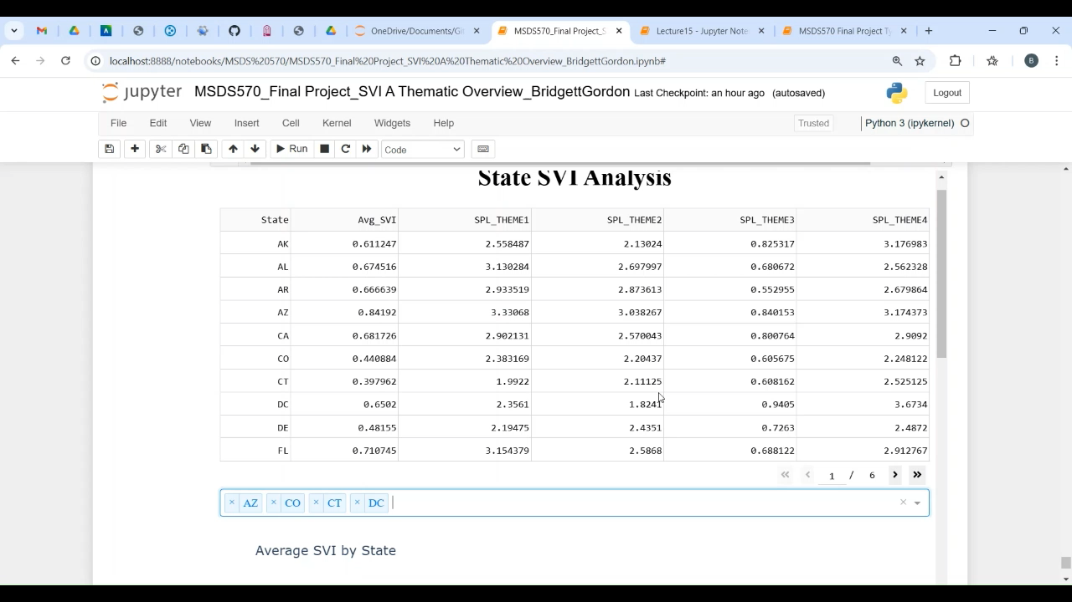
Dash: multi-select for trends and comparisons
Notes:
Insert a picture illustrating a custom or tradition here.

Slide 24
Insights and Interpretation
Notes:
Insert a map of your country.

Slide 25
Key Findings:
Social vulnerability Index levels increase in the Southernmost and Southwest states.
SVI scores appear to be medium-high to high for the Economic Profile Layers that include:
Poverty – Theme 1
Unemployment – Theme 1
Education (no high school diploma) – Theme 1
Single Parent Households – Theme 2
State with Highest SVI: Arizona (0.8419)
State with the Lowest SVI: North Dakota (0.2023)
Notes:
Poverty: Percentage of persons below 150% poverty estimate
Unemployed: Percentage of civilian (age 16+) unemployed estimate

Slide 26
Challenges
Notes:
Insert a map of your country.

Slide 27
Challenges faced
Technical Limitations
Rerunning of code
Timing conflict with work and other school projects
Notes:
Technical Limitations: I really wanted to make my county svi map a hover over map by using Choropleth.px but I couldn’t get it to work
Not really knowledgeable with creating github repositories and when pushing my code to github somethings did not appear in my outputs
Rerunning Code: My computer kept freezing up on me

Slide 28
Future work
Notes:
Insert a map of your country.

Slide 29
Suggested improvements
More time to explore other datasets to use
Implement more advanced techniques like tableau
Use more interactive techniques like (hover)

Slide 30
references
Notes:
Insert a map of your country.

Slide 31
resources
Sources of Datasets:
SVI Values by County
https://data.cms.gov/tools/mapping-disparities-by-social-determinants-of-health
SVI Themes by County
https://www.atsdr.cdc.gov/placeandhealth/svi/data_documentation_download.html
Articles:
https://pubmed.ncbi.nlm.nih.gov/37380956/
https://bmcpublichealth.biomedcentral.com/articles/10.1186/s12889-023-16097-6

Slide 32
Questions/Thank You
Notes:
Insert a map of your country.

